Slide 1
Bone Age Prediction
Abhishek Nimmakayala
Akhil Kumar Baipaneni

Slide 2
Outline
Introduction
Problem Statement
Data set description
Exploratory Data Analysis
Preliminary model
CNN Model
Conclusions
Future work
References

Slide 3
Introduction
A bone age study helps doctors estimate the maturity of a child's skeletal system. It's usually done by taking a single X-ray of the left wrist, hand, and fingers.
A child's bone age (also called the skeletal age) is assigned by determining which of the standard X-ray images in the atlas most closely match the appearance of the child's bones on the X-ray.

Slide 4
Problem Statement & Motivation
In this project we aim to train a model on the x-ray images of childrens hands and predict the bone age of children, by doing so we can find any abnormalities in the growth of a child’s bone and also find difference between a child's bone age and his or her chronological age which might indicate a growth problem

Slide 5
Data set description
The data set is obtained from kaggle and holds 9 GB of data.
A total of 12611 images are available.
Good resolution images (1514*2044 pixels)
.CSV file which has image id, bone age, gender

Slide 6
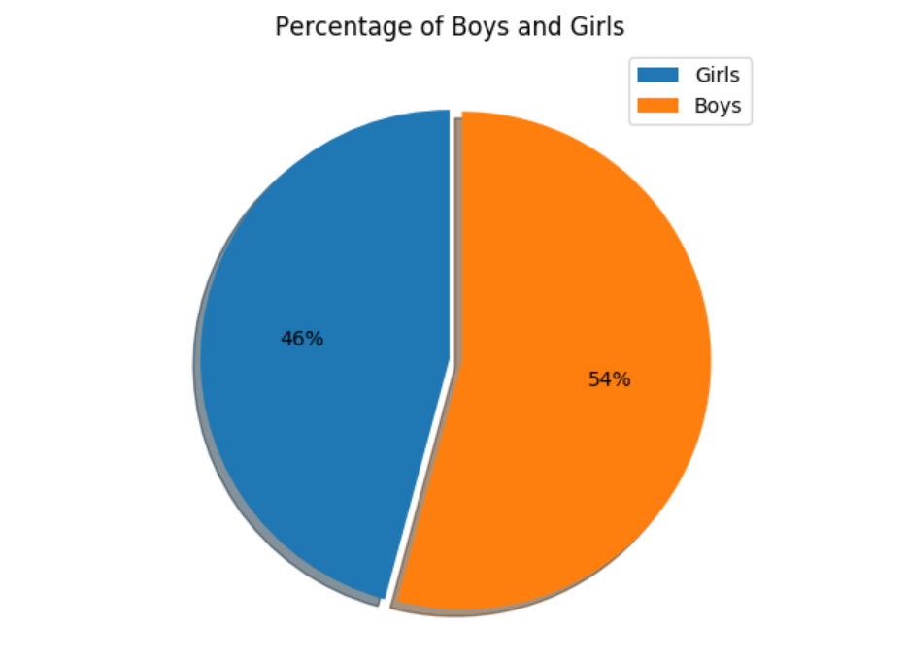
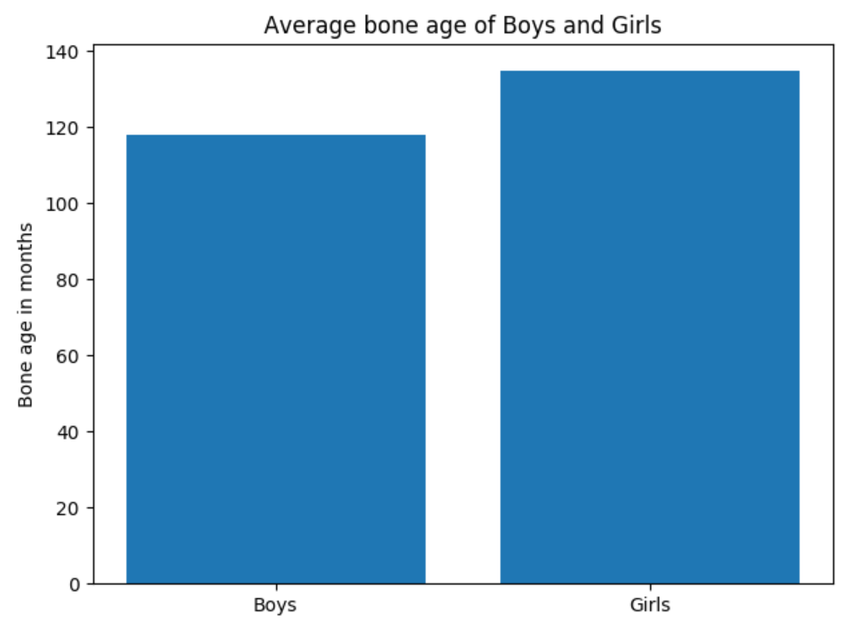
Exploratory data analysis

Slide 7
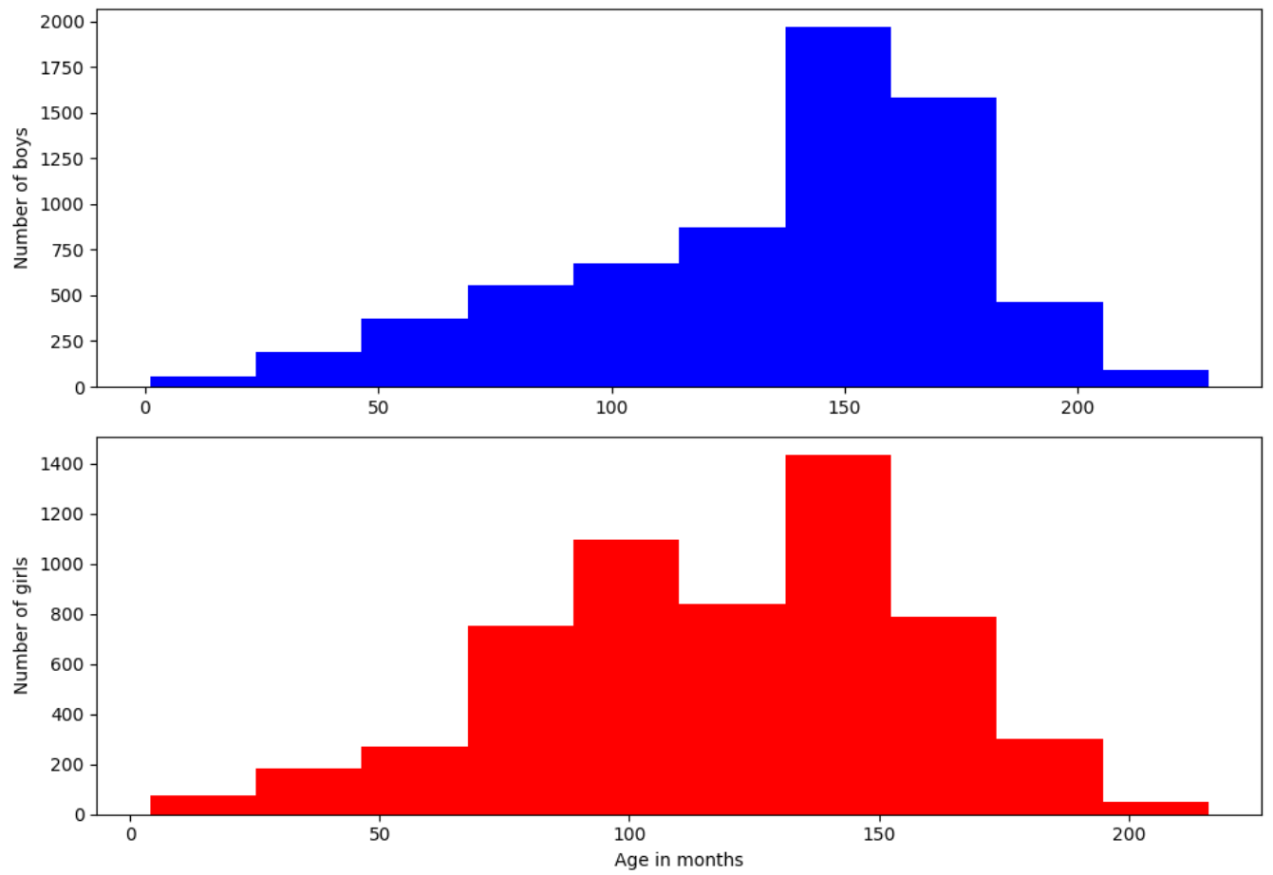
EDA Contd..

Slide 8
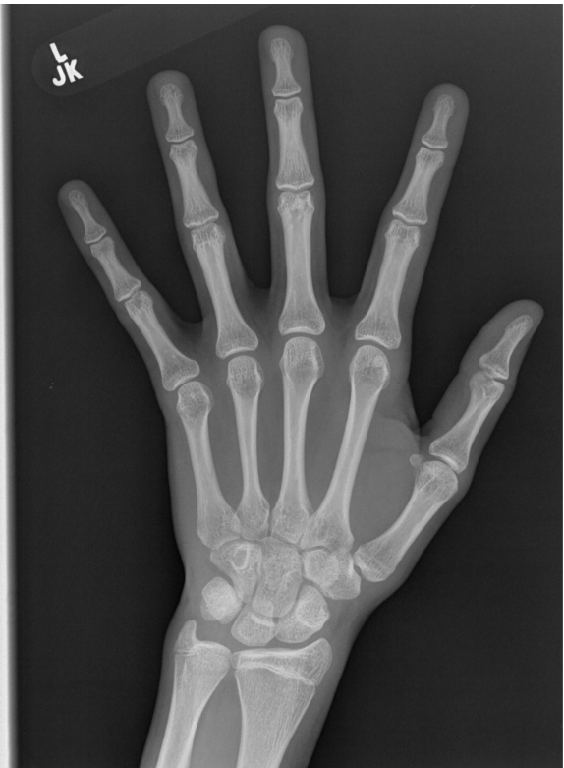
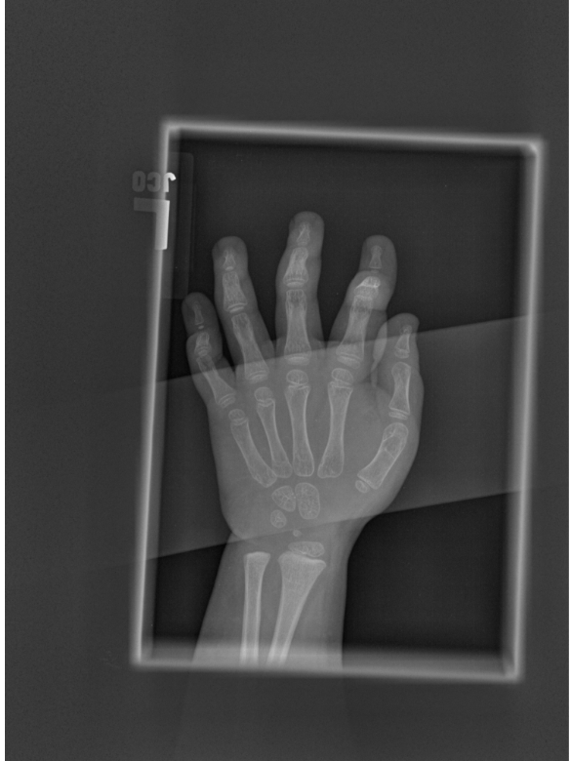
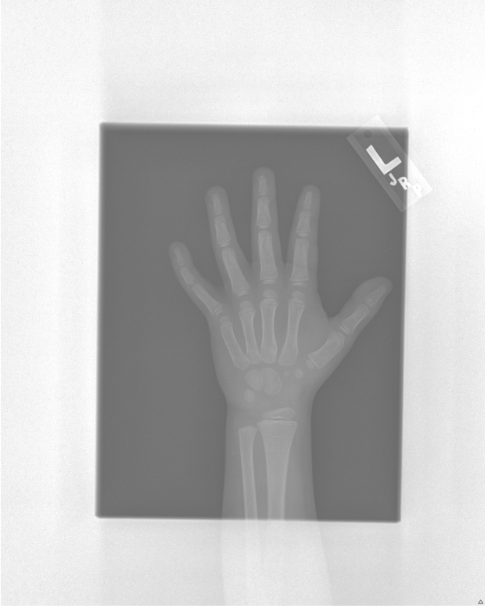
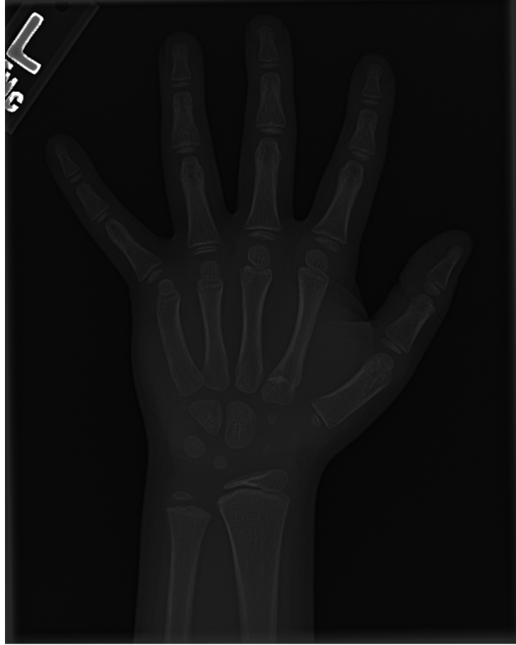
Glimpse into the dataset
Image 1 Image 2 Image 3 Image 4

Slide 9
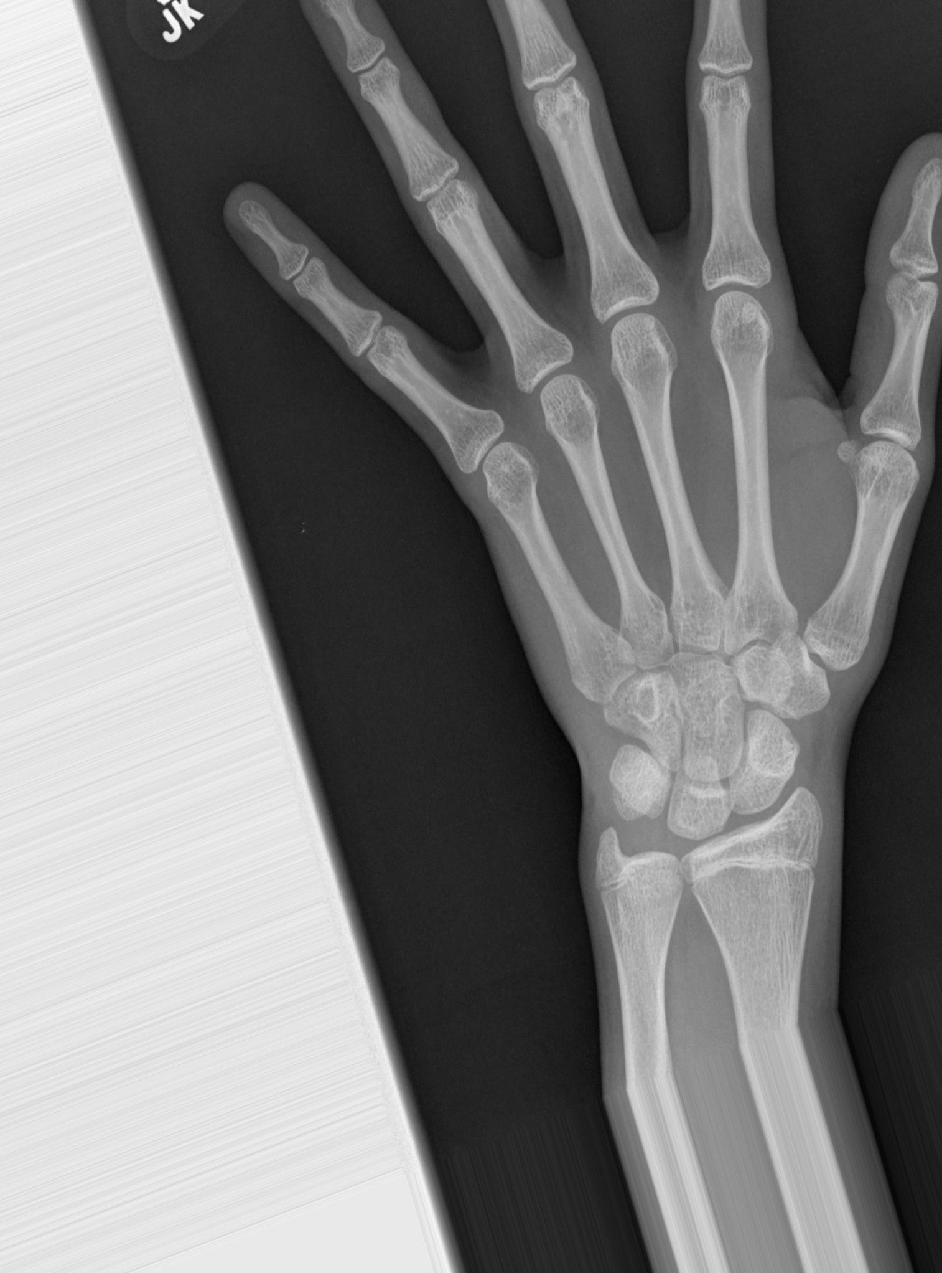
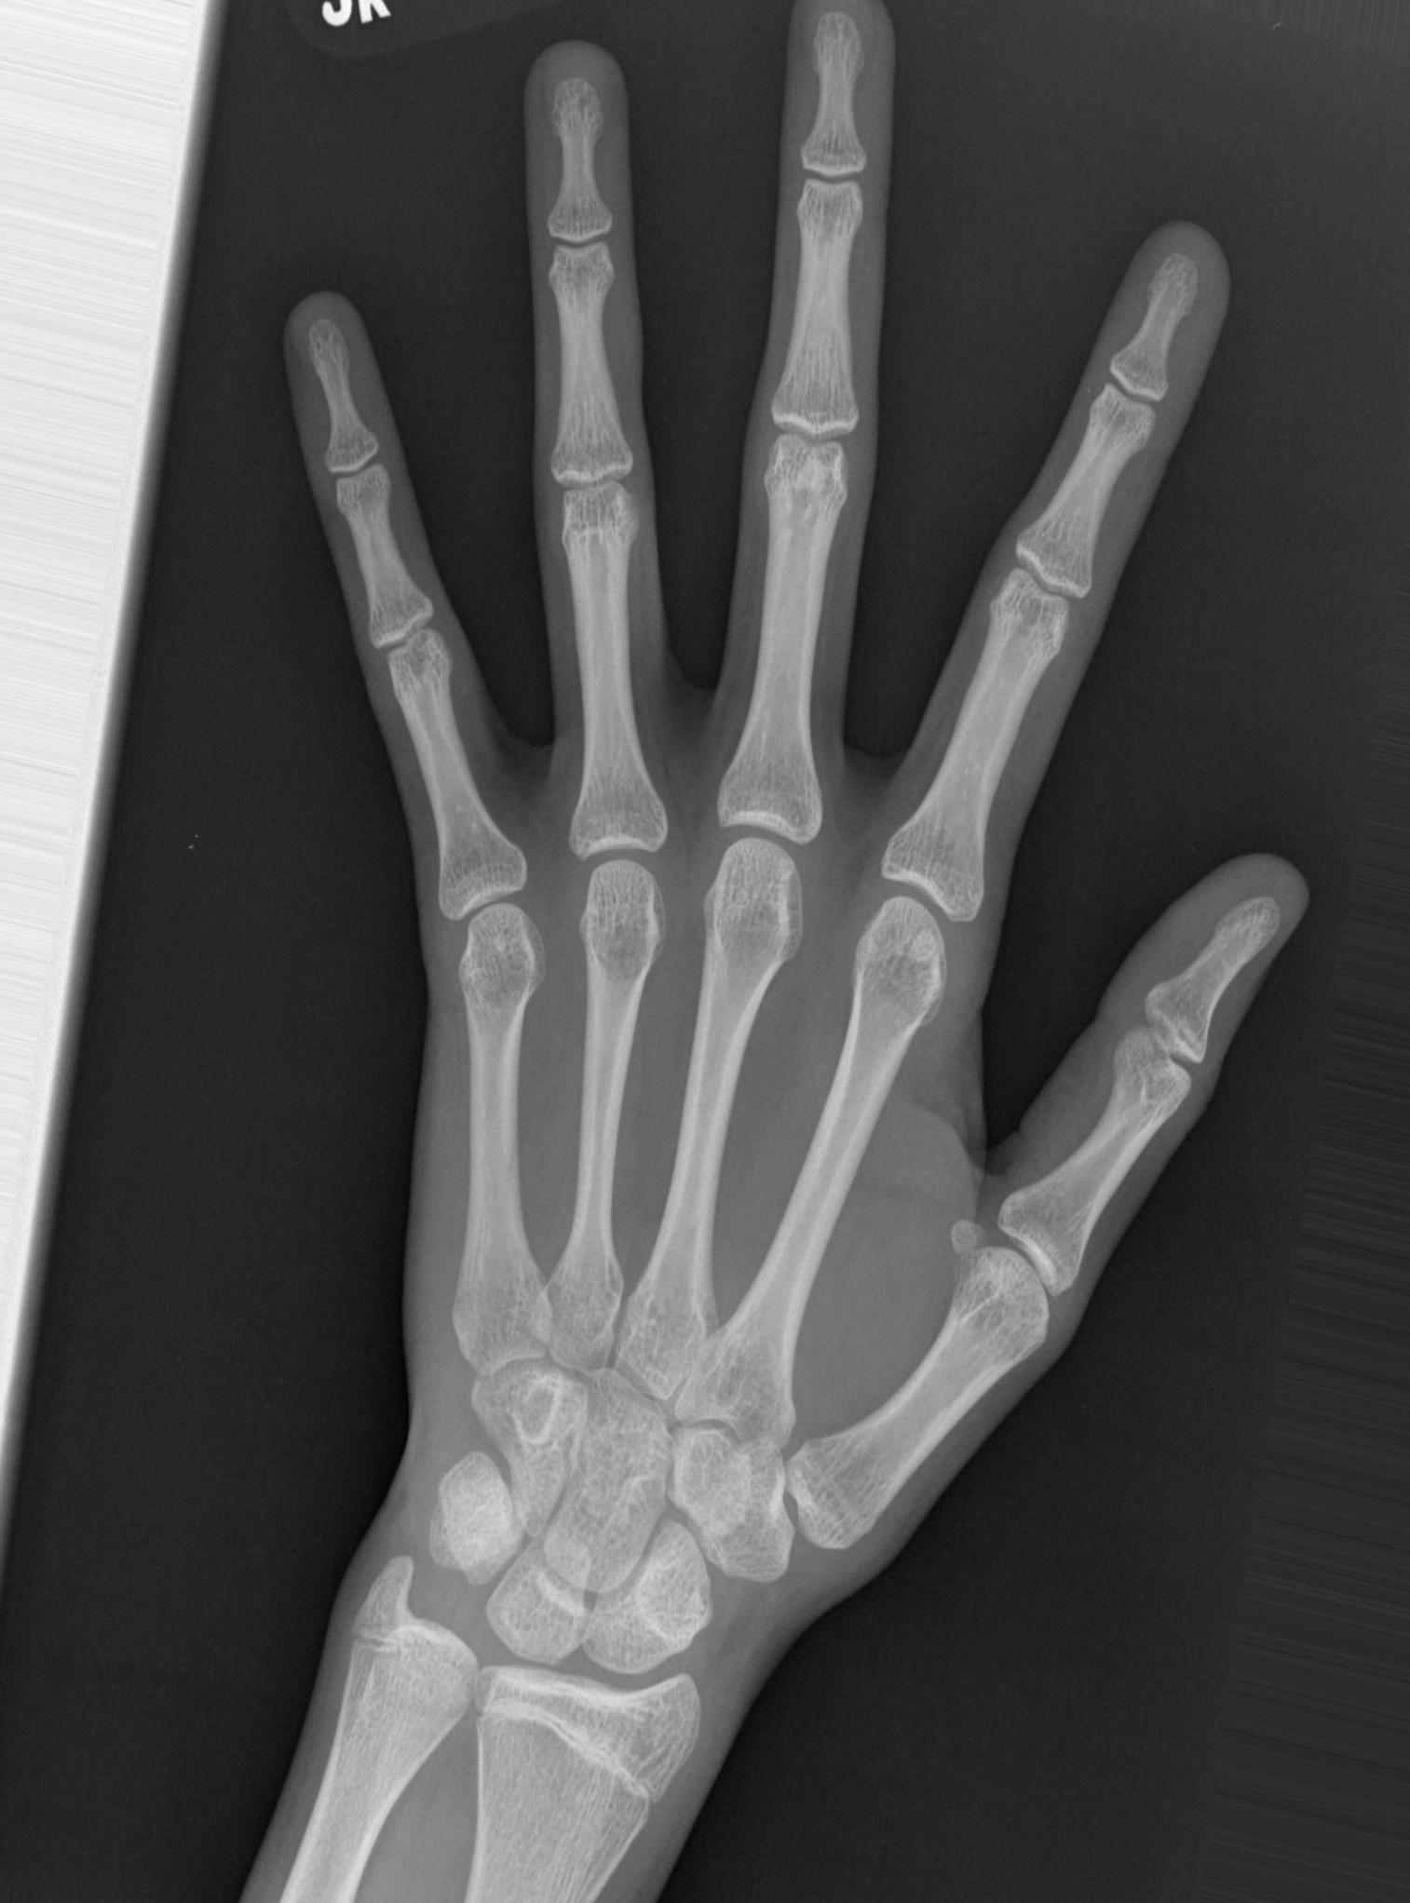
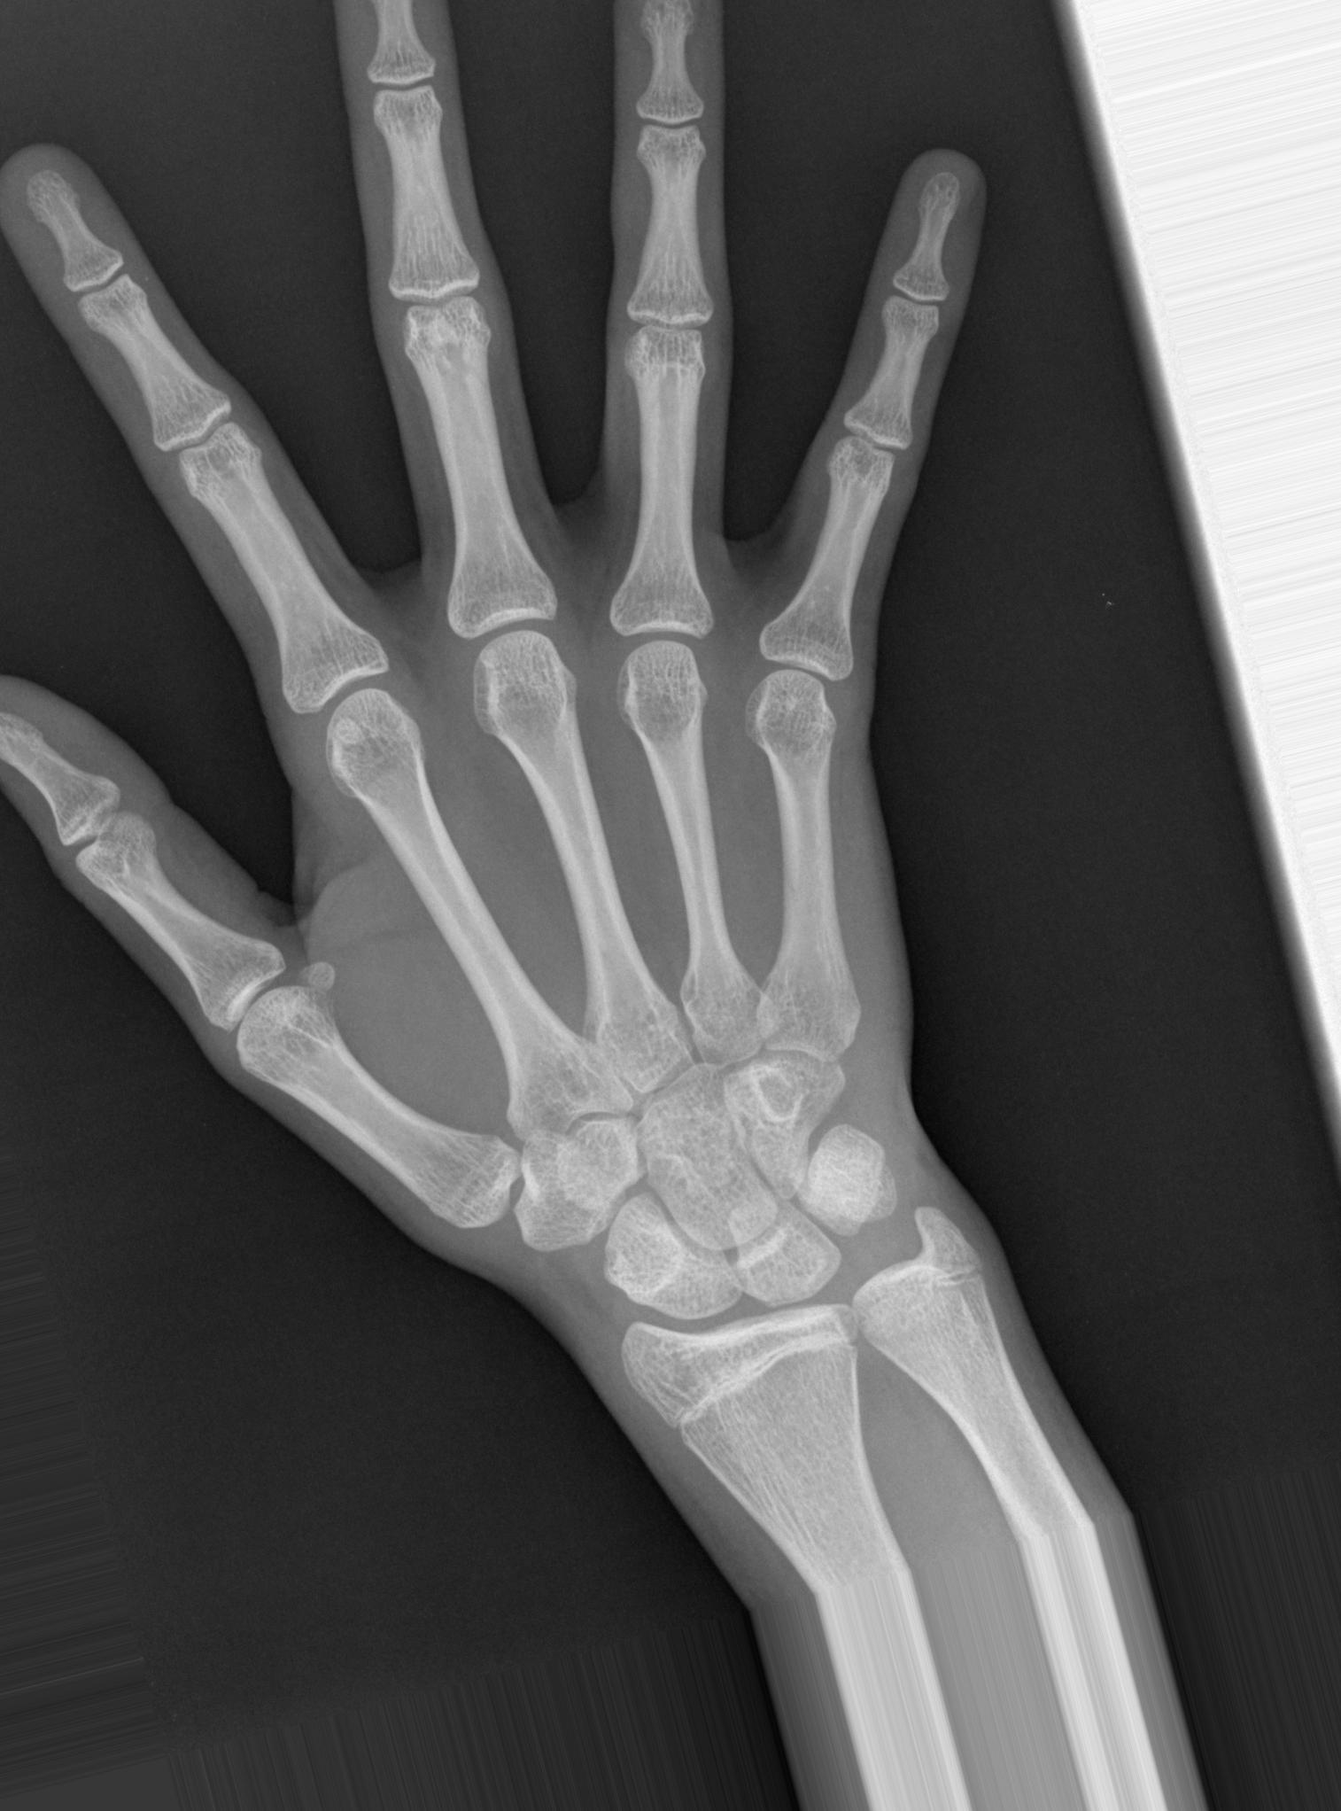
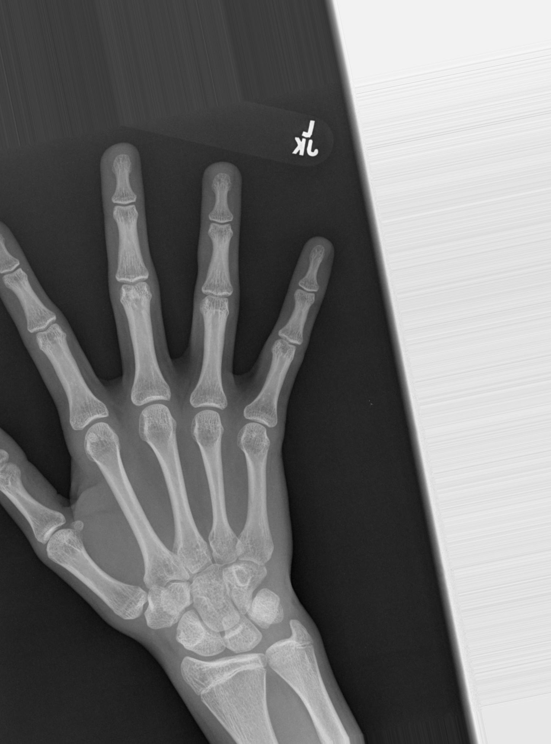
Image data generator
Parameters used:
rotation_range=20,
width_shift_range=0.2,
height_shift_range=0.2,
zoom_range=0.3,
fill_mode='nearest',
horizontal_flip=True,
brightness_range=[0.5, 1]

Slide 10
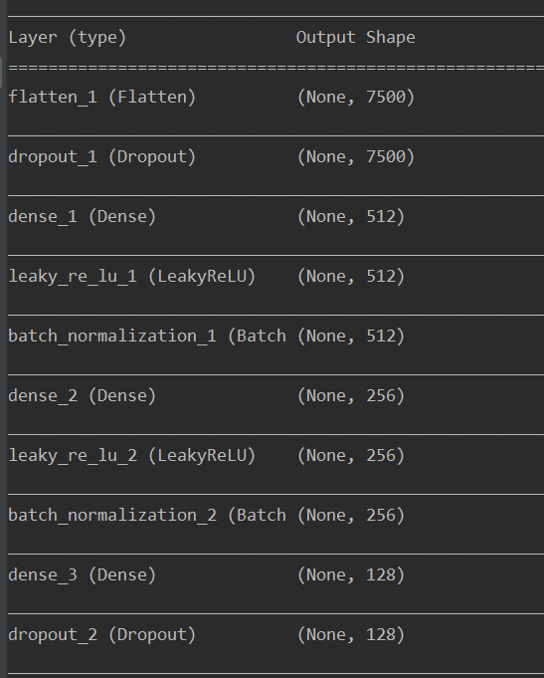
Preliminary model Architecture

Slide 11
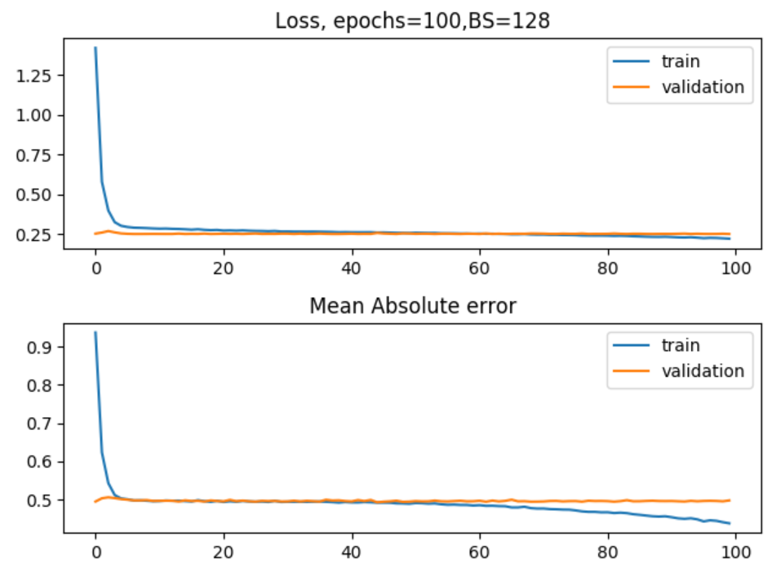
Preliminary model results
There is a huge drawback in this model

Slide 12
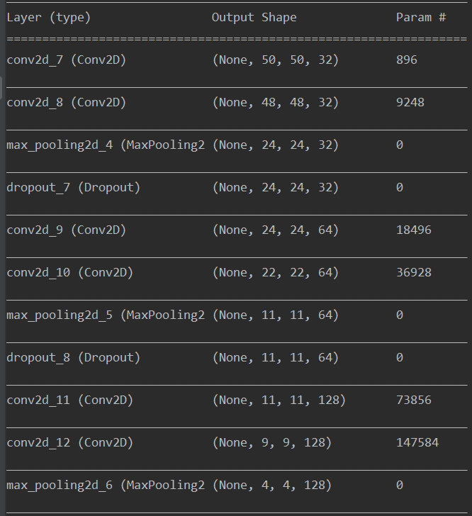
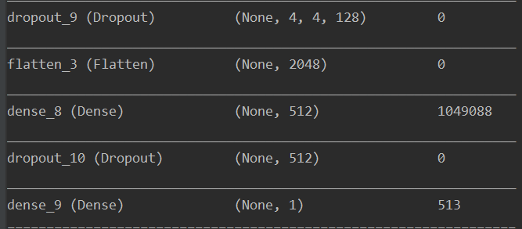
CNN Model

Slide 13
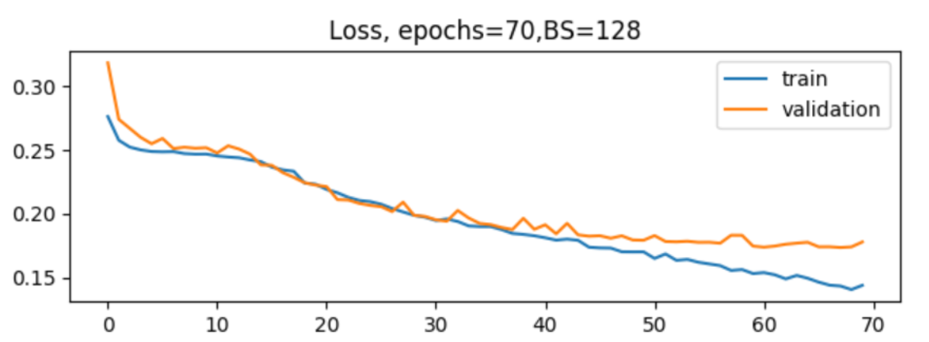
CNN results
L
O
S
S
Number of Epochs

Slide 14
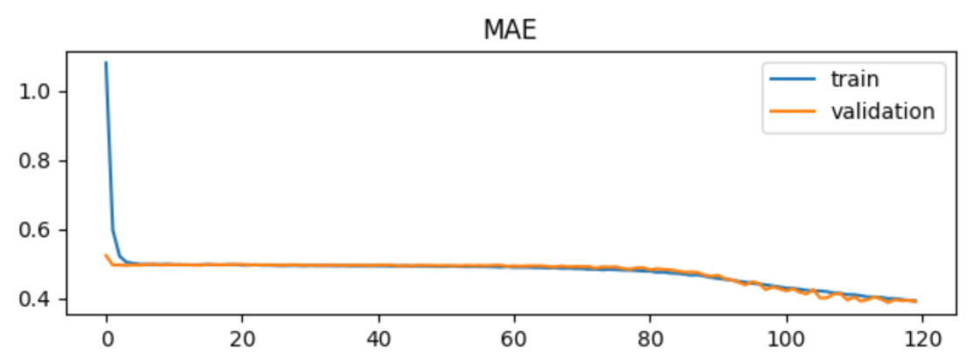
Train vs validation Mean absolute error

Slide 15
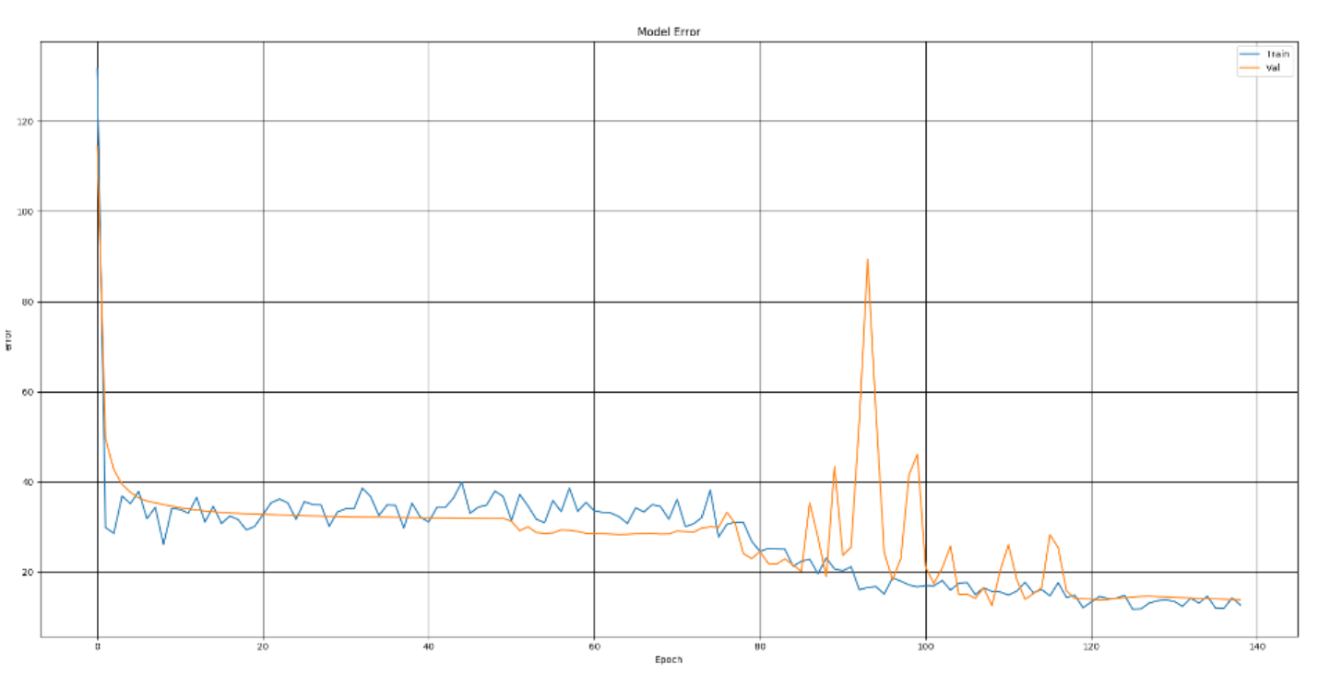
Xception Pre trained model

Slide 16
Conclusions
The simple MLP model had a validation loss of 0.25, validaton MAE of 0.49, and validation MSE of 0.24
The CNN model has a validation loss of 0.17, validation MAE of 0.34 and validation MSE of 0.18
The Xception model has a validation loss of 0.15, MAE in months is 13.9
The Pre trained model had the least loss when compared among all the models

Slide 17
Future work
We would like to use the gender information as well for training and see how it impacts the results
Use different pre-trained models to our data and experiment
Convert the bone age data into appropriate bins and build a model

Slide 18
THANK YOU…!

